Slide 1
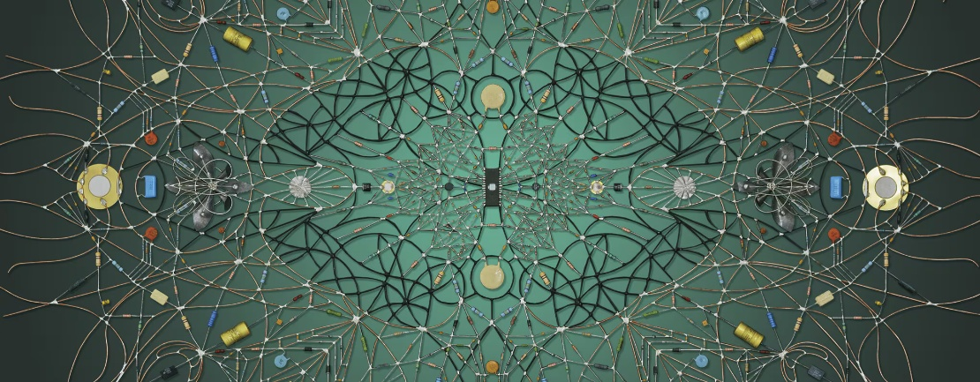
EE 2031 Electric Circuits
Week 1
Introduction
Circuit variables
Circuit elements

Slide 2
Preliminaries
Class schedule: | Monday 15:00 – 17:00 (M1.Z01) Tuesday 15:00 – 16:00 (M2.Z11)
Instructor: | Dr. Kamil Erdayandı, kamil.erdayandi@marmara.edu.tr Office: M2-232, Phone: (216) 777 3535

Slide 3
Preliminaries
Attendance: | Classroom attendance (%70) is mandatory.
Quizzes: | There will be three quizzes.
Homework(s): | There may be some homework assignments.
P.S. | There may be problem sessions before the exams.

Slide 4

Recommended textbook

Slide 5
Syllabus
Grading:
 | Quizzes | 15%
 | HW | (N_{H} x 5) %
 | Midterm | 45 - (N_{H} x 5) %
 | Comprehensive Final | 40% N_{H} : Number of homework assignments.

Slide 6
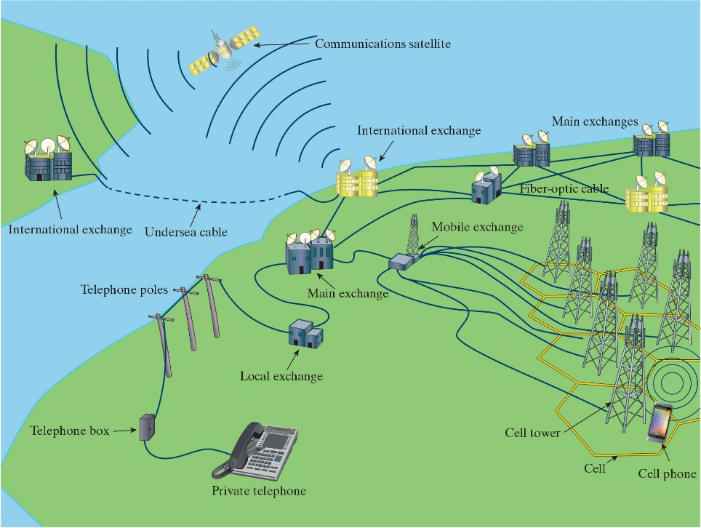
Electric Circuits Applications – Communication Systems

Slide 7

Electric Circuits Applications – Computing Systems
Our current modern PCs could be made possible thanks to electric circuit.

Slide 8
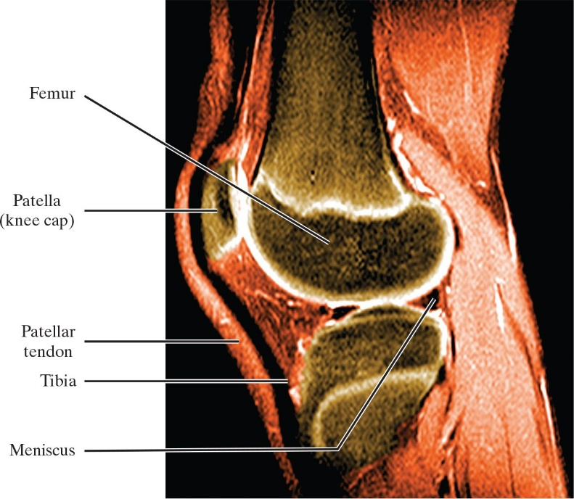
Electric Circuits Applications – Signal Processing Systems

Slide 9
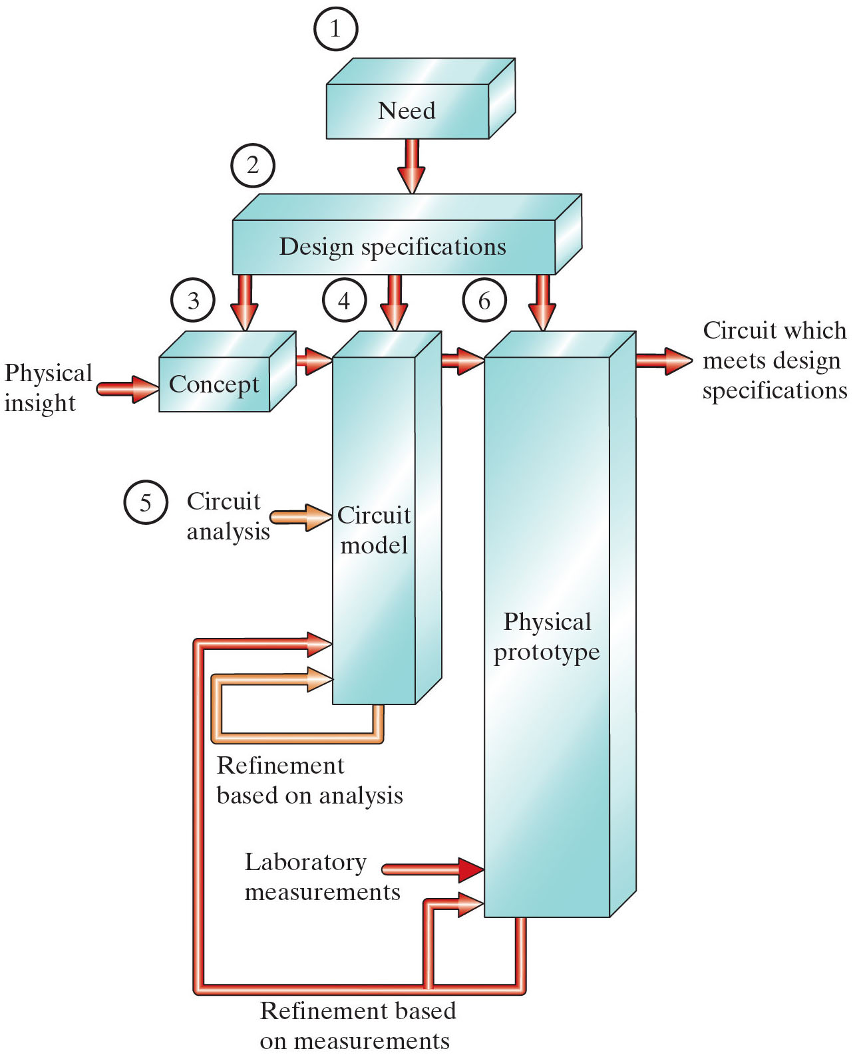
Chapter 1 – Circuit Variables (3 of 21)
Section 1.3
How does circuit theory fit into the overall scheme of things?

Slide 10
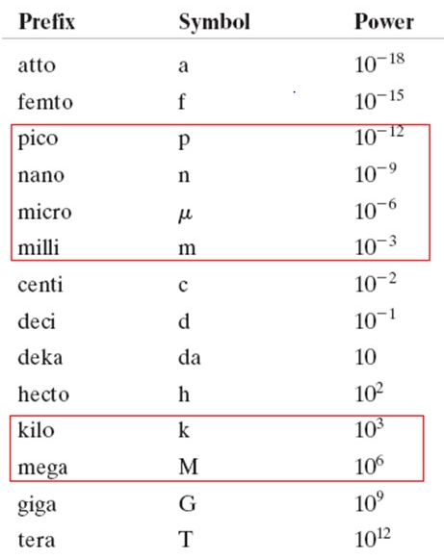
Chapter 1 – Circuit Variables (2 of 21)
Memorize the boxed prefixes – we use them ALL THE TIME!!
Table 1.3 Standardized Prefixes to Signify Powers of 10

Slide 11
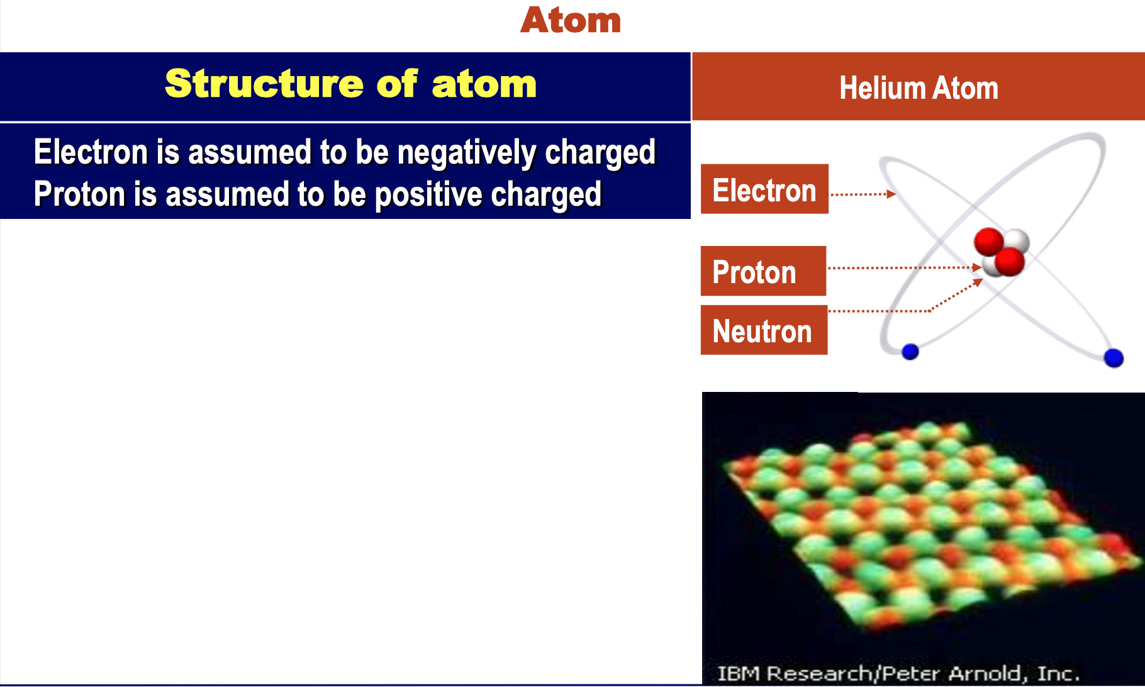
Basic Principles

Slide 12
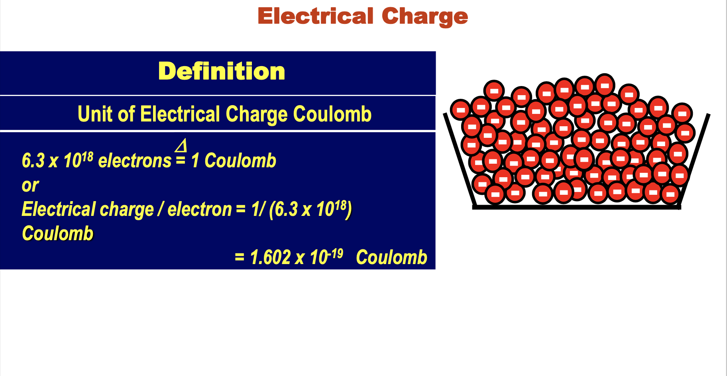
Basic Principles

Slide 13
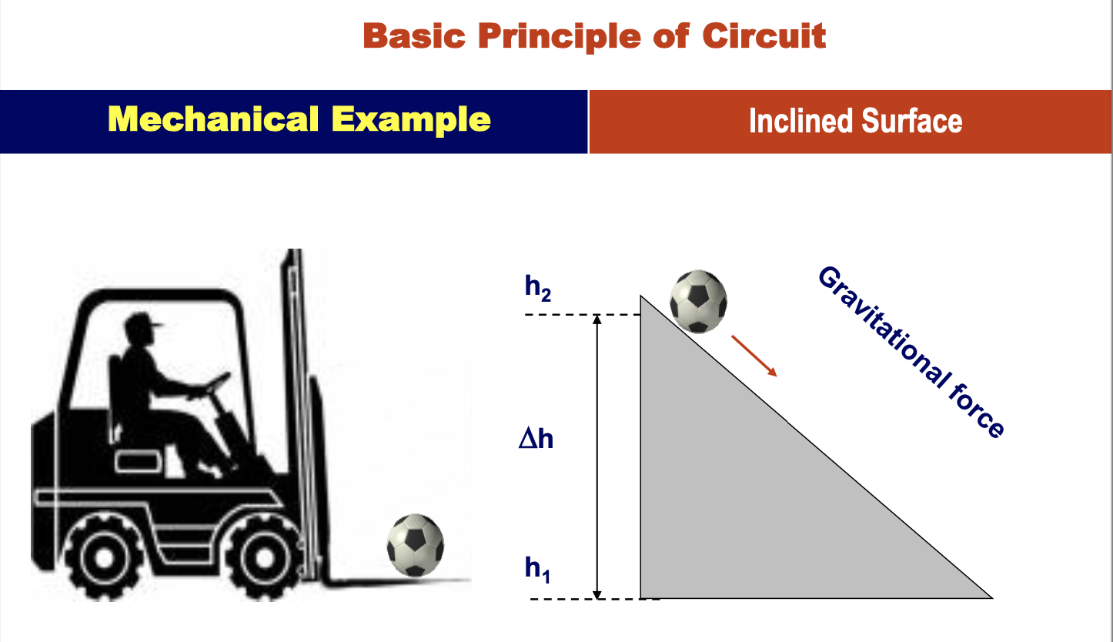
Basic Principles

Slide 14
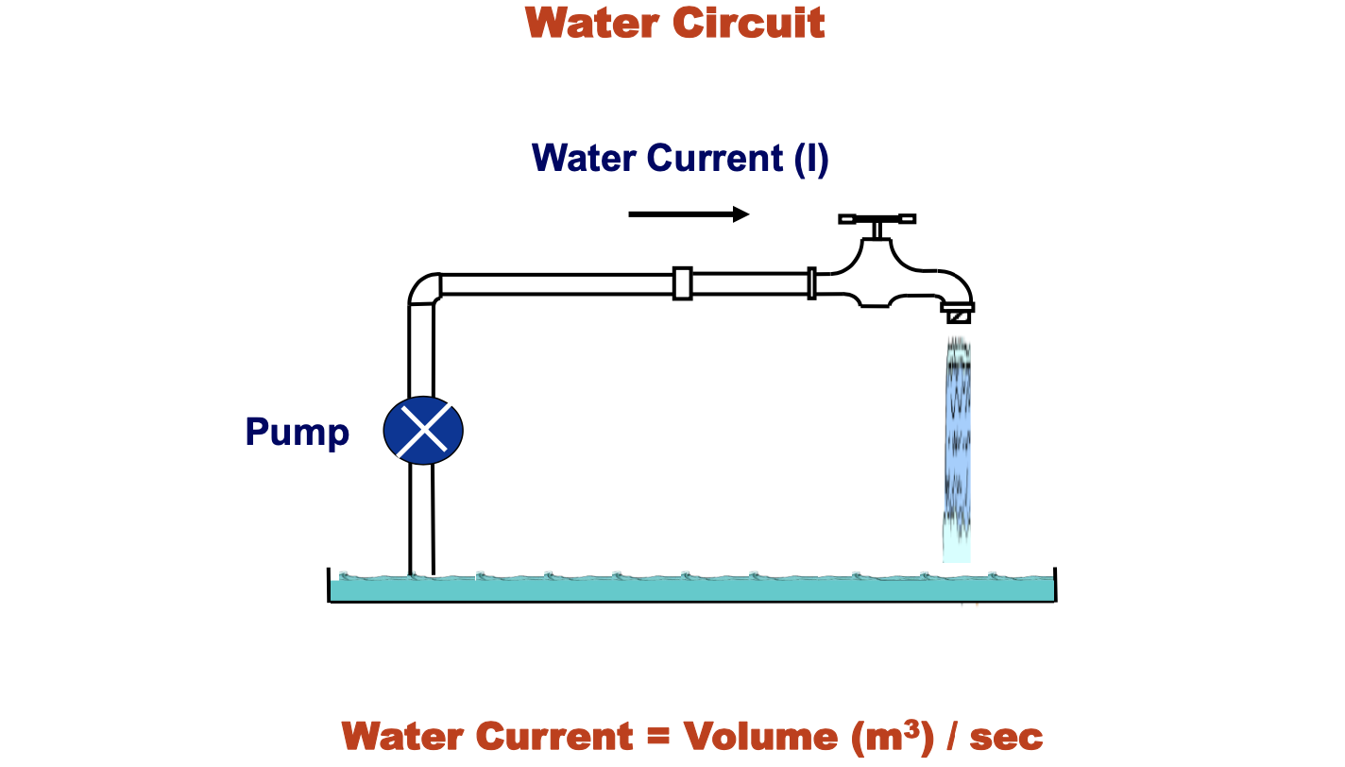
Basic Principles

Slide 15
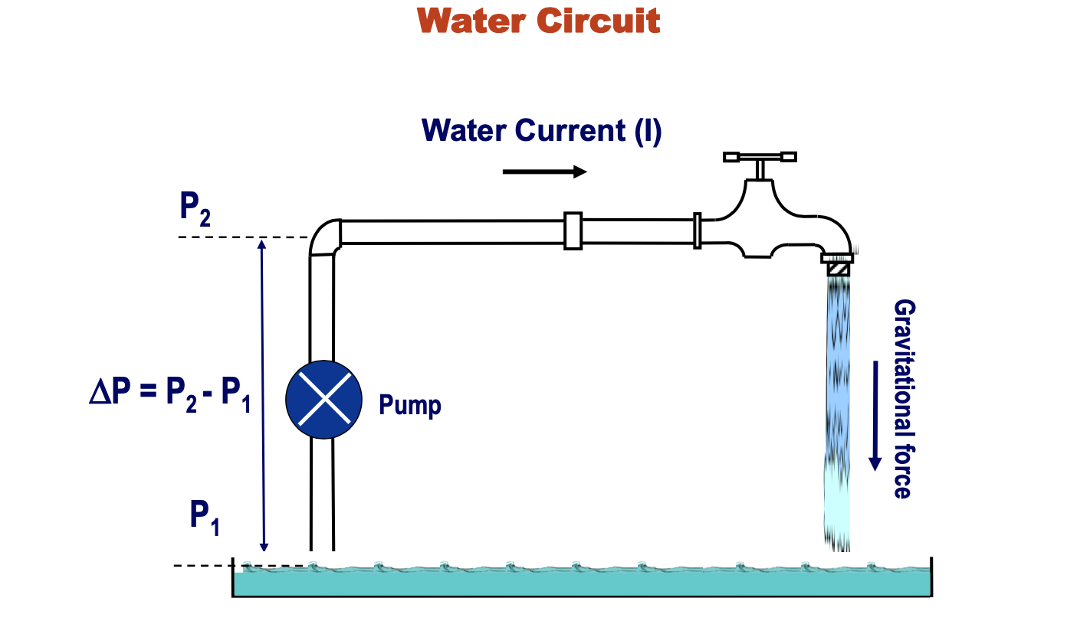
Basic Principles

Slide 16
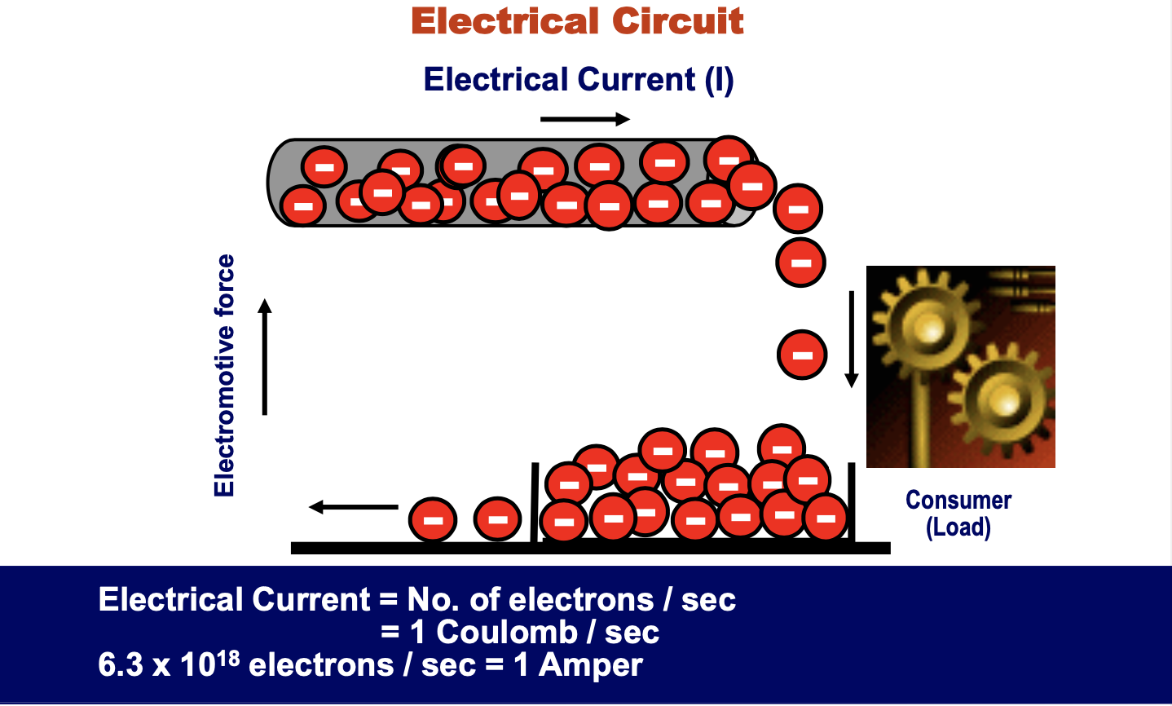
Basic Principles

Slide 17
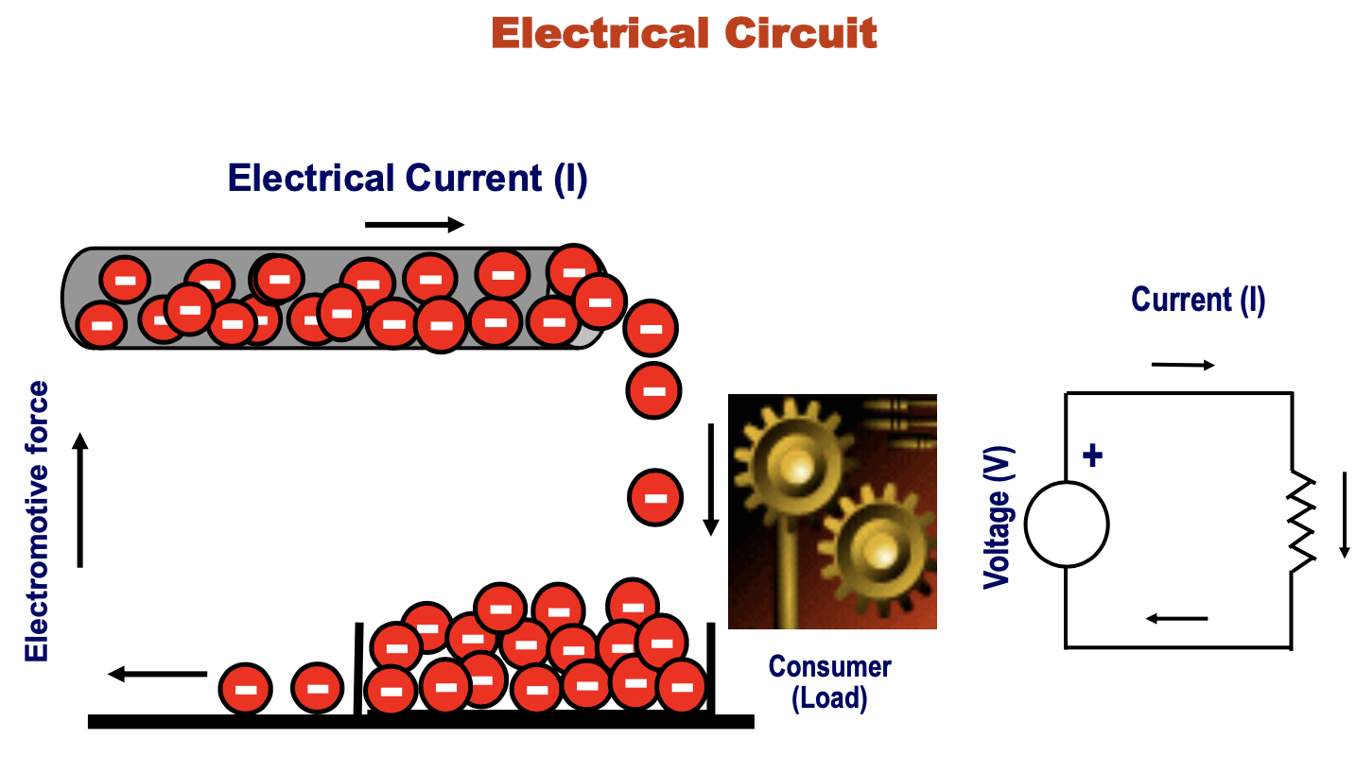
Basic Principles

Slide 18
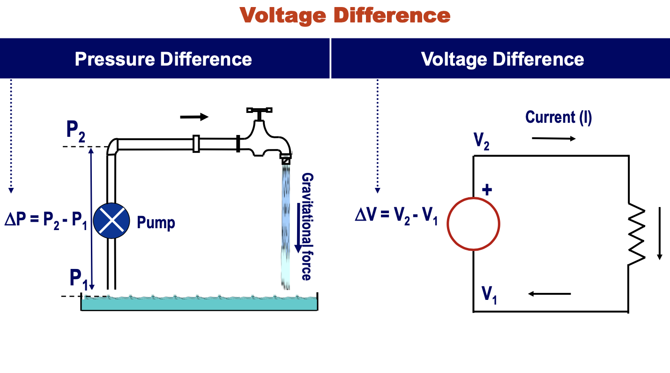
Basic Principles

Slide 19
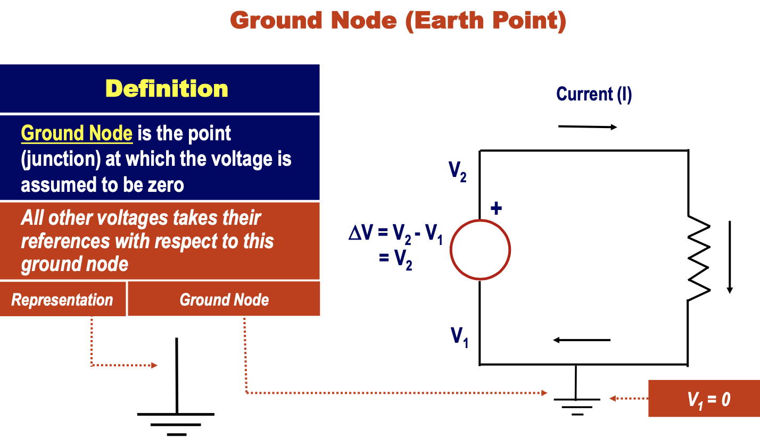
Basic Principles

Slide 20
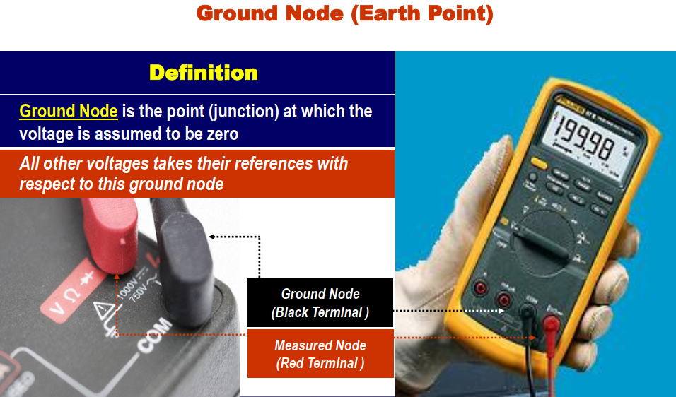
Basic Principles

Slide 21
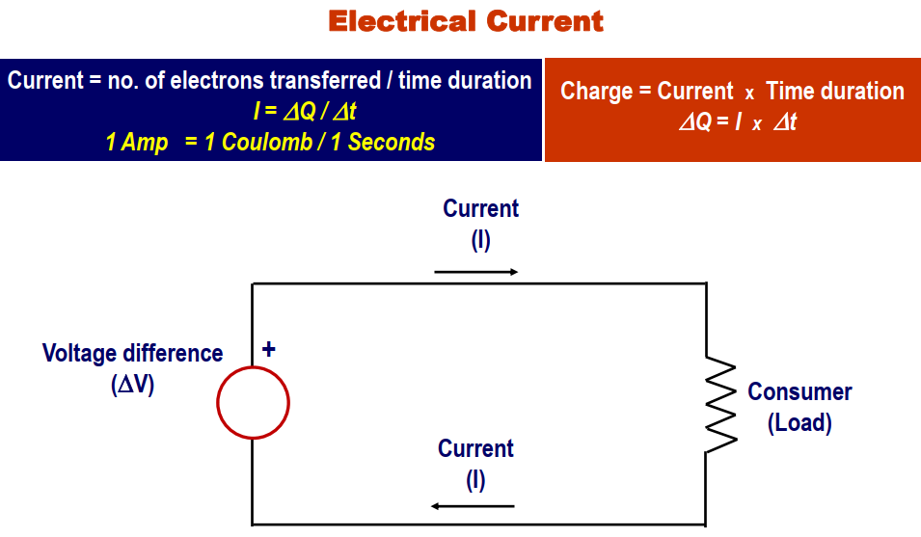
Basic Principles

Slide 22
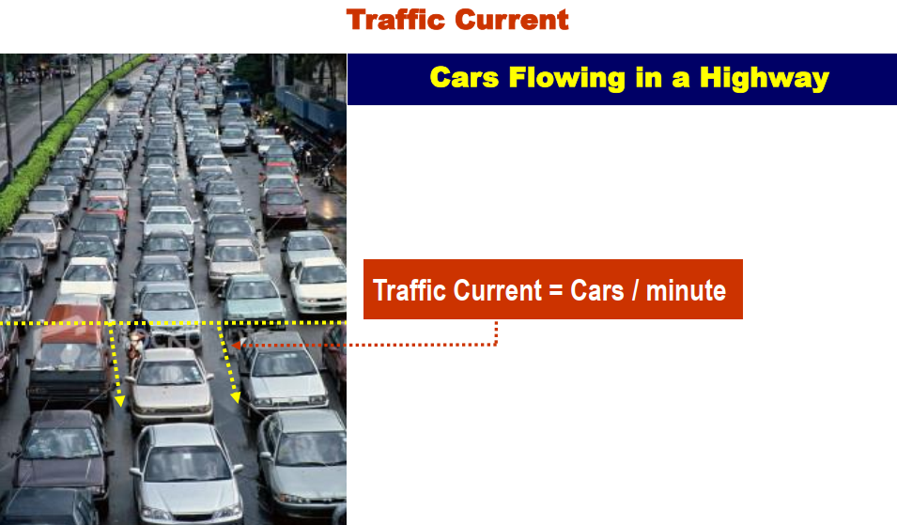
Basic Principles

Slide 23
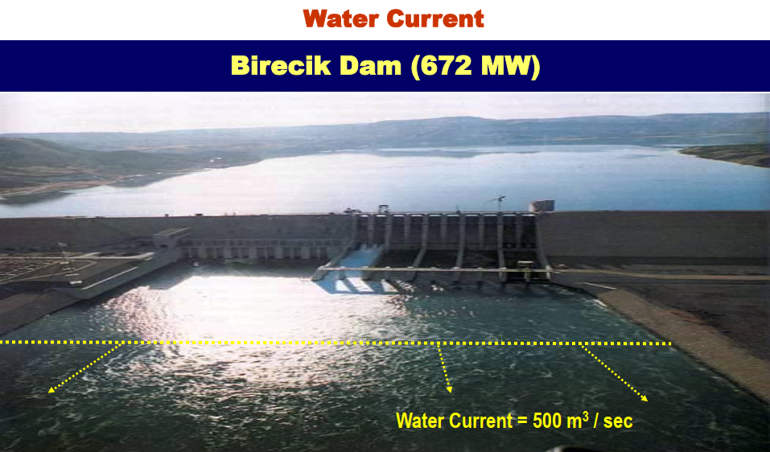
Basic Principles

Slide 24
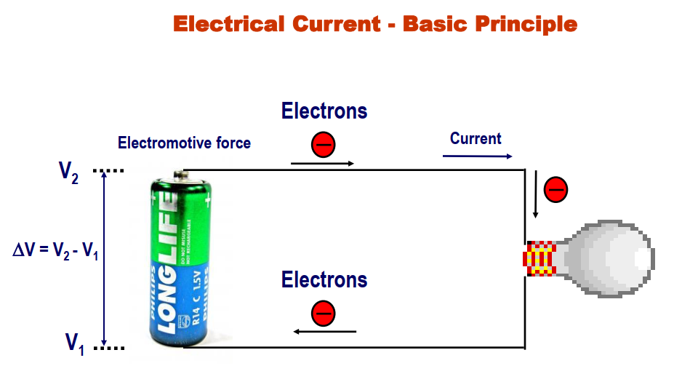
Basic Principles

Slide 25
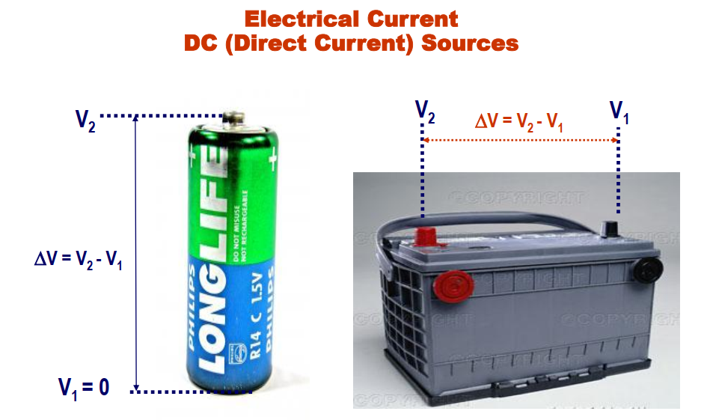
Basic Principles

Slide 26
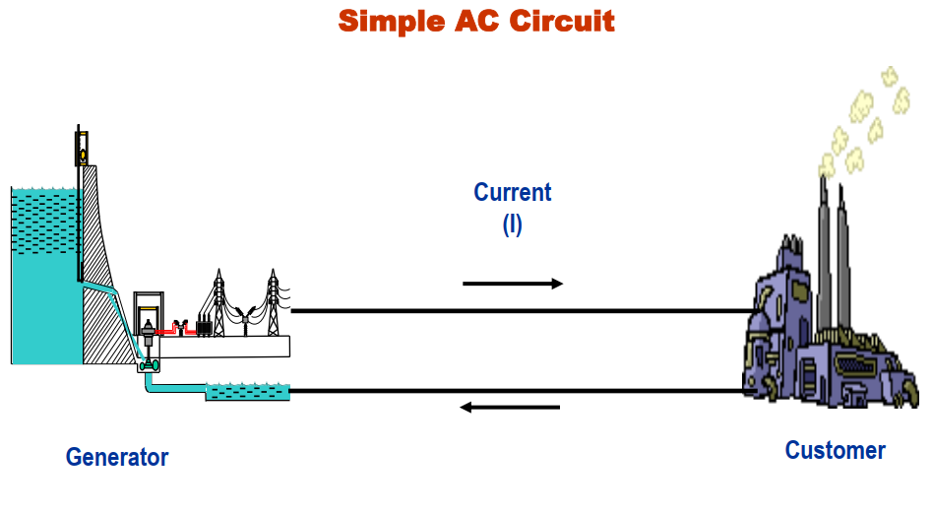
Basic Principles

Slide 27
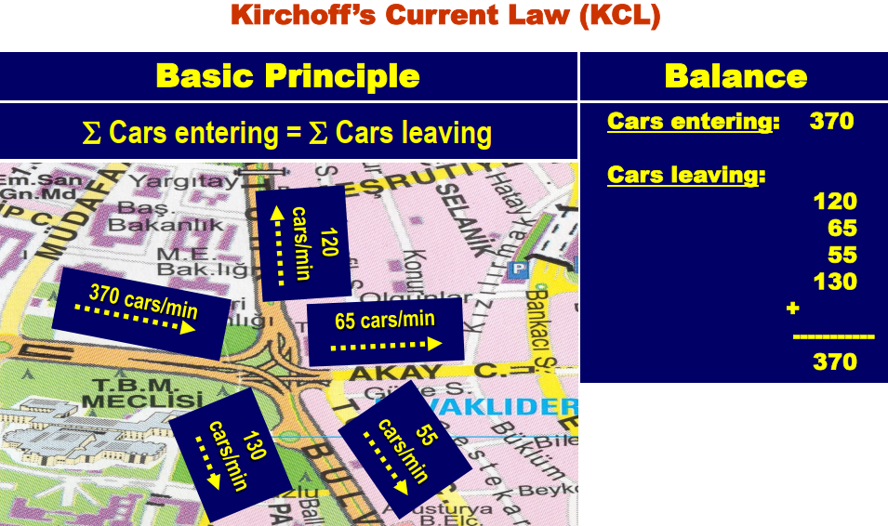
Basic Principles

Slide 28
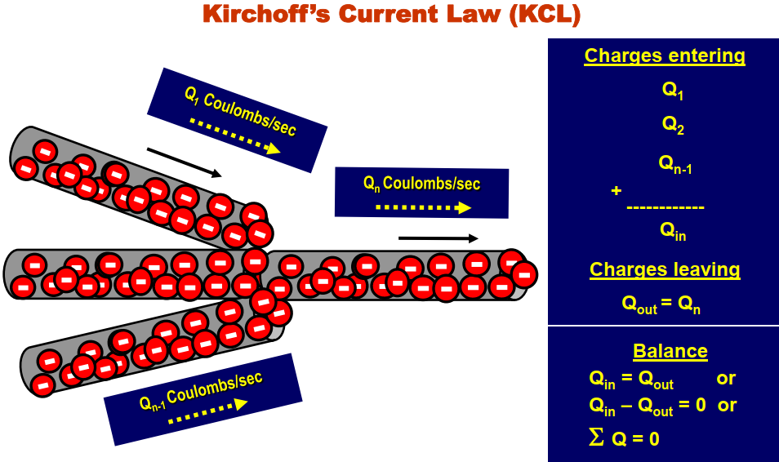
Basic Principles

Slide 29
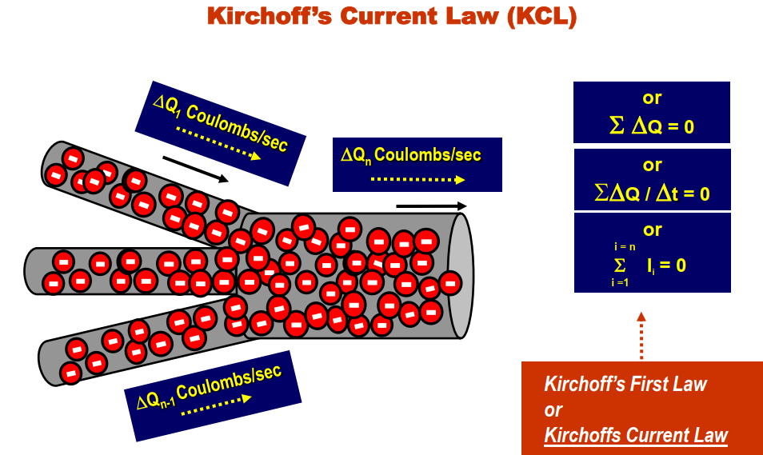
Basic Principles

Slide 30
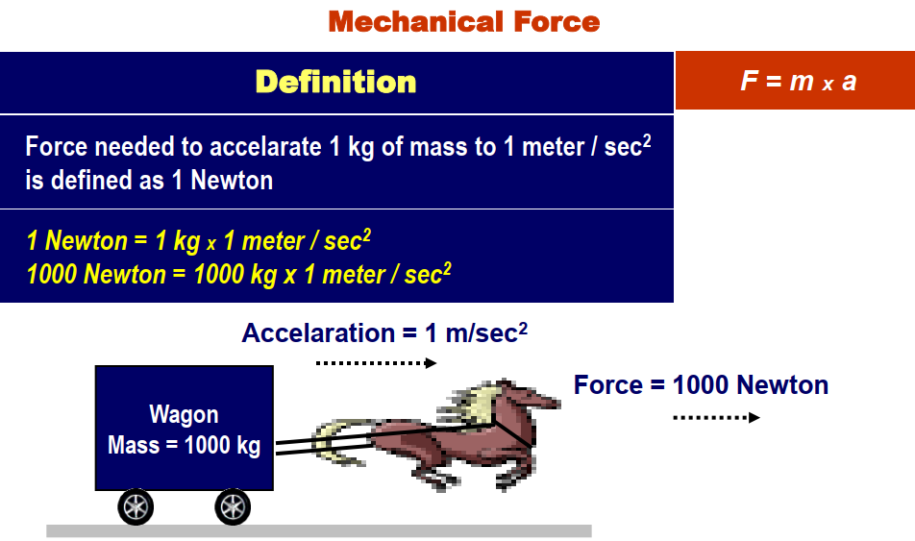
Basic Principles

Slide 31
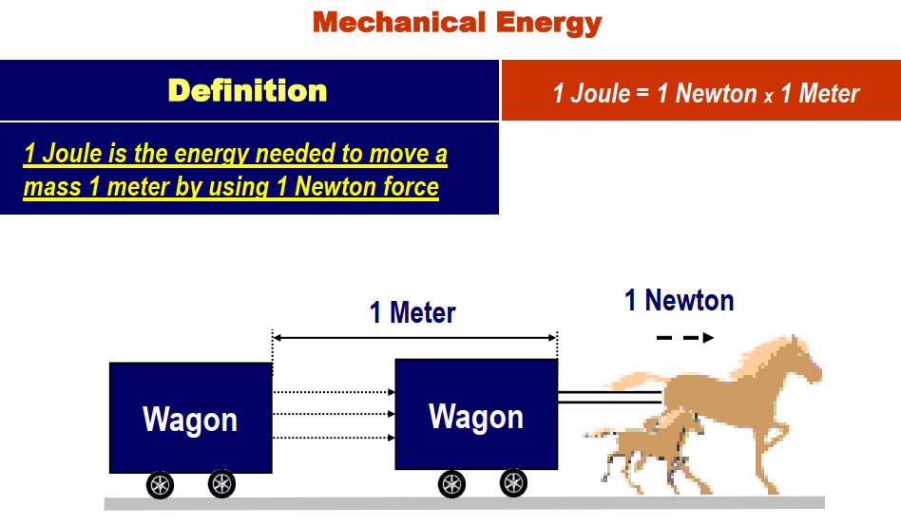
Basic Principles

Slide 32
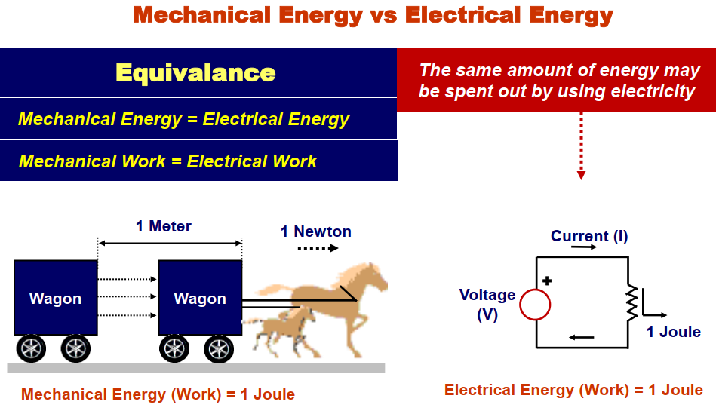
Basic Principles

Slide 33
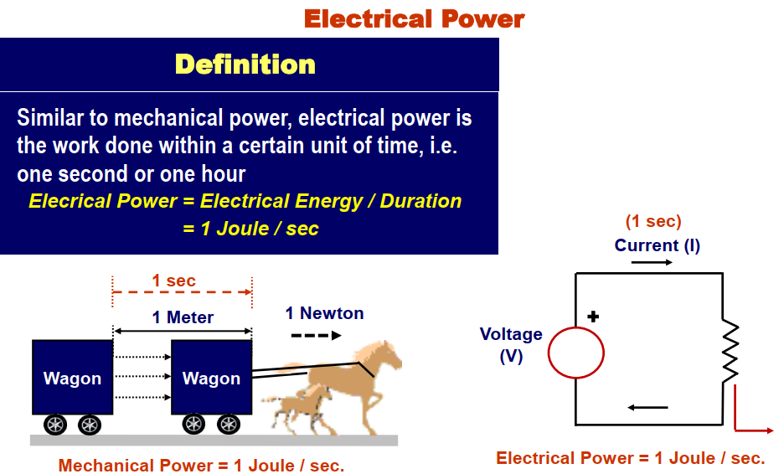
Basic Principles

Slide 34
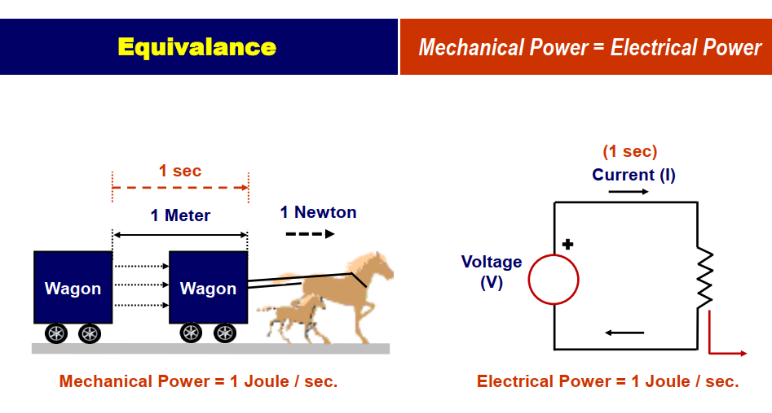
Basic Principles

Slide 35
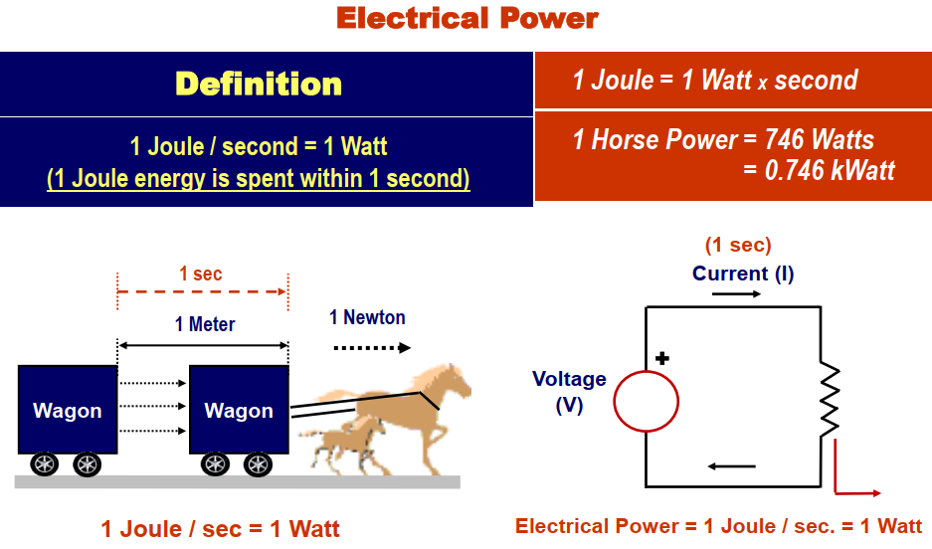
Basic Principles

Slide 36
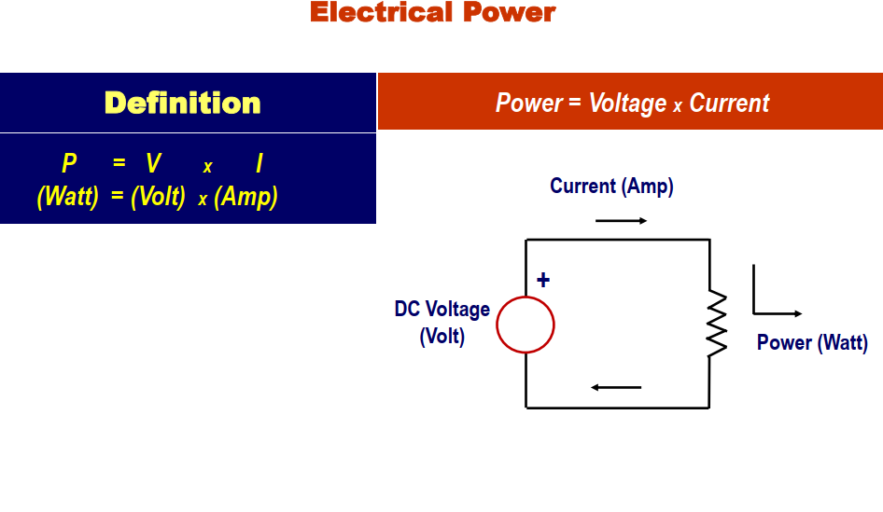
Basic Principles

Slide 37
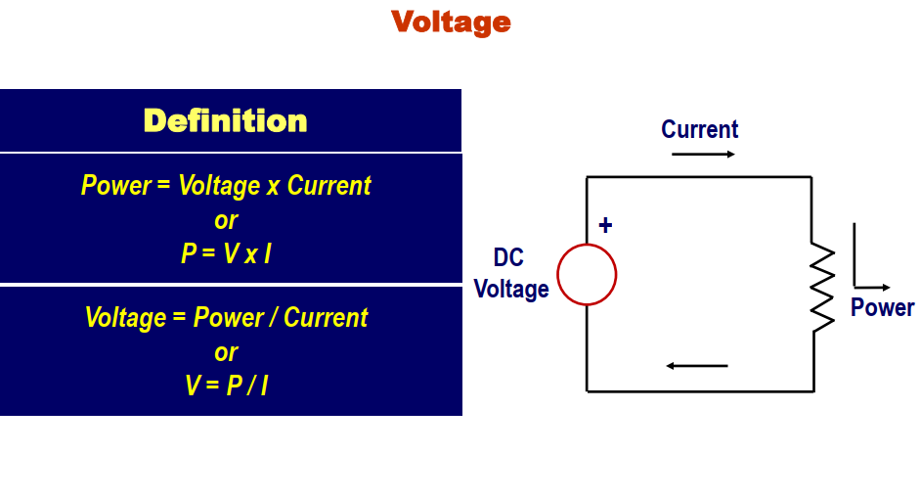
Basic Principles

Slide 38
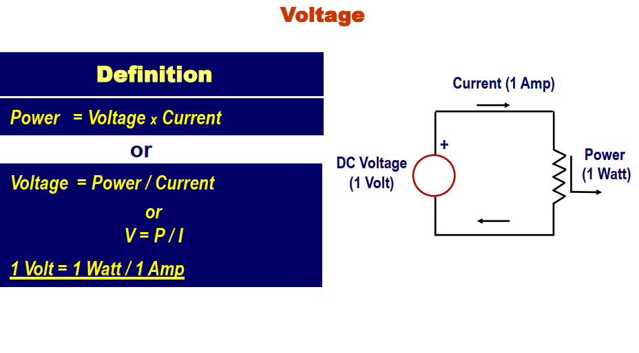
Basic Principles

Slide 39
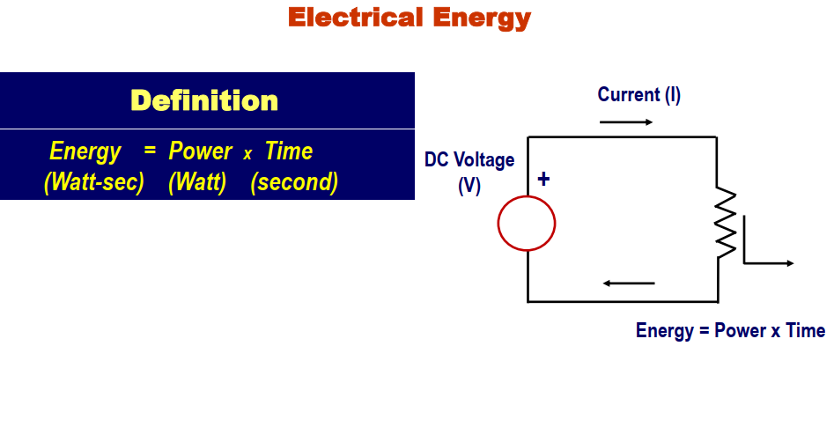
Basic Principles

Slide 40
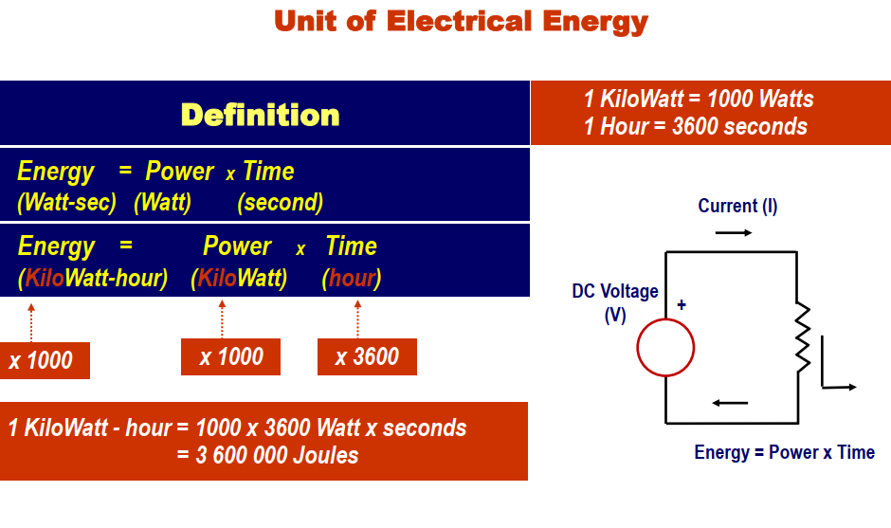
Basic Principles

Slide 41
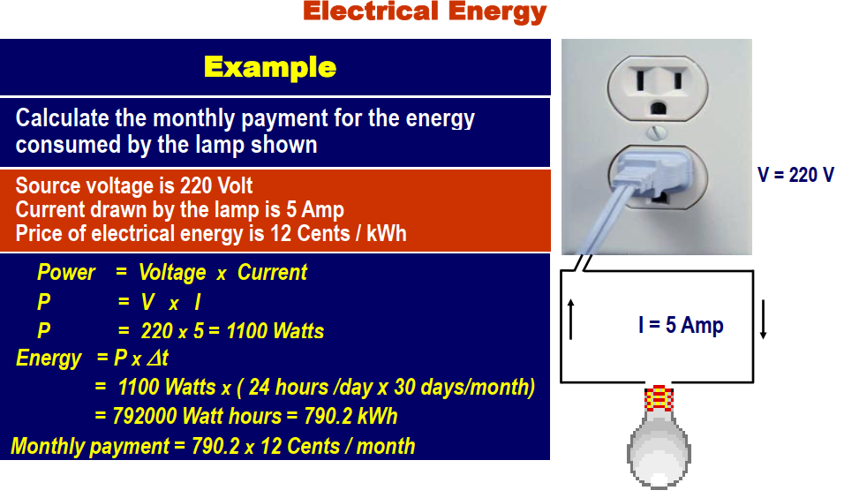
Basic Principles

Slide 42
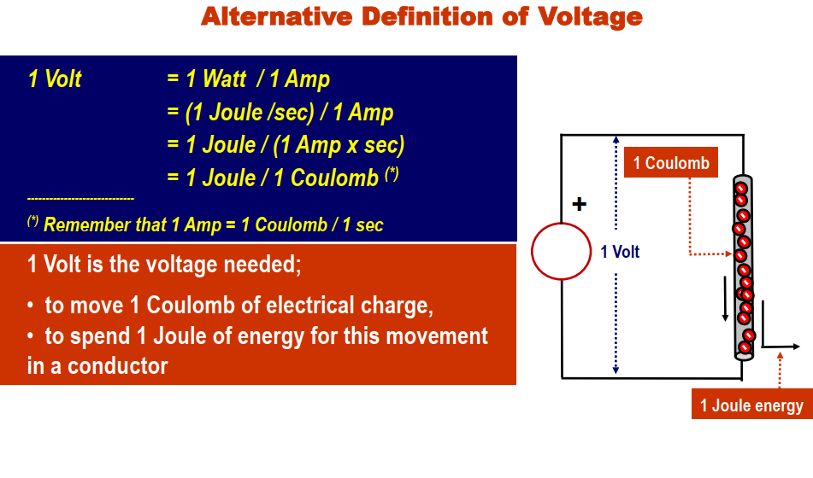
Basic Principles

Slide 43

Chapter 1 – Circuit Variables (4 of 21)
Section 1.4
Voltage
  Definition – the energy per unit charge created when +
  and
  charges are separated.
  Defining equation:
where
v is voltage in volts [V]
w is energy in joules [J]
q is charge in coulombs [C]

Slide 44

Chapter 1 – Circuit Variables (5 of 21)
Section 1.4 (continued)
Current
  Definition – the time rate of change of charge flow.
  Defining equation:
where
i is current in amperes [A]
q is charge in coulombs [C]
t is time in seconds [s]

Slide 45
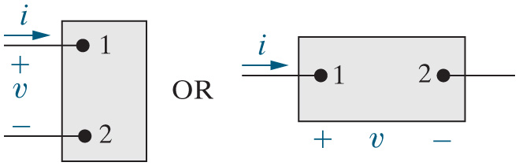
Chapter 1 – Circuit Variables (6 of 21)
Section 1.5
Ideal Basic Circuit Element
  Ideal – the element can be described solely in terms of the relationship between its voltage and its current.
  Basic – the element cannot be sub-divided into simpler elements.
  Circuit Element – the element has two terminals used to connect it to other elements and form a circuit.

Slide 46

Chapter 1 – Circuit Variables (7 of 21)
Section 1.6
Power
  Definition – the time rate of change of energy.
  Defining equation:
where
p is power in watts [W]
w is energy in joules [J]
t is time in seconds [s]
  Note that energy is the integral over time of power!

Slide 47


Chapter 1 – Circuit Variables (8 of 21)
Section 1.6 (continued)
More on power:
Memorize this!!

Slide 48

Chapter 1 – Circuit Variables (9 of 21)
Section 1.6 (continued)
More on power:
  Actually,
  How do you know which sign to use???
The passive sign convention:
  “Whenever the reference direction for the current in an element is in the direction of the reference voltage drop across the element, use a positive sign in any expression that relates the voltage to the current. Otherwise, use a negative sign.”

Slide 49
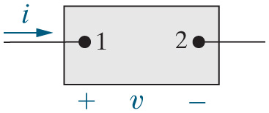

Chapter 1 – Circuit Variables (10 of 21)
Section 1.6 (continued)
The practical passive sign convention:
If the current arrow points to the + terminal of the voltage, use a + sign in the equation. Otherwise, use a − sign.
For the ideal basic circuit element above,

Slide 50
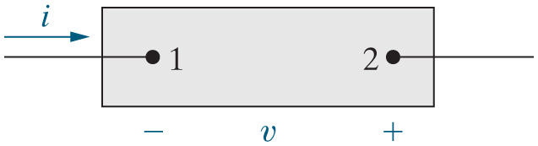

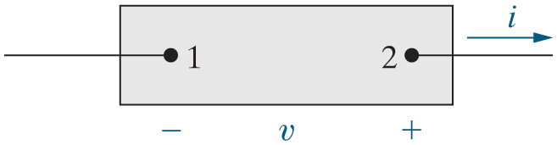
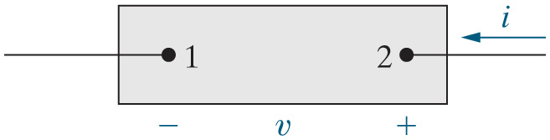

Chapter 1 – Circuit Variables (11 of 21)
Section 1.6 (continued)
Passive sign convention examples:

Slide 51
Chapter 1 – Circuit Variables (12 of 21)
Section 1.6 (continued)
What is the meaning of positive power and negative power?
  When the power associated with a circuit element is negative, the circuit element is generating (delivering, supplying) power to the circuit.
  When the power associated with a circuit element is positive, the circuit element is absorbing (dissipating) power from the circuit.

Slide 52
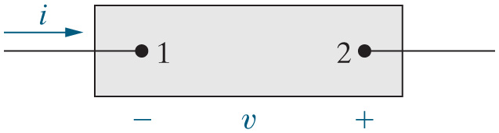
Chapter 1 – Circuit Variables (13 of 21)
Section 1.6 (continued)
Examples of interpreting the algebraic sign of power:
Is power supplied or absorbed? Supplied
Is power supplied or absorbed? Supplied
Is power supplied or absorbed? Absorbed

Slide 53








Chapter 1 – Circuit Variables (14 of 21)
Chapter 1 examples:
Find the total charge entering terminal 1.
Notes:
Long Description:
q subscript total Base Line equals Integral from 0 to infinity of 20 e to the negative 5000 t power d t plus 0 equals Start Fraction 20 over negative 5000 End Fraction e to the negative 5000 t power, evaluation at upper limit infinity and lower limit 0.

Slide 54
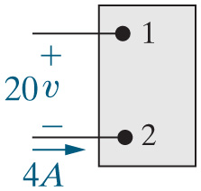
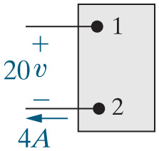




Chapter 1 – Circuit Variables (16 of 21)
Chapter 1 examples: Assessment Problem 1.5 (modified)
Find the power associated with the circuit elements below. State whether the power is generated or absorbed.

Slide 55

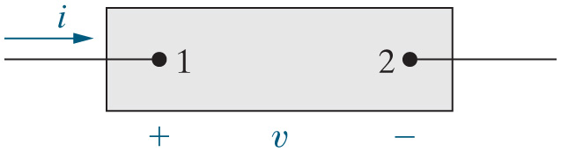



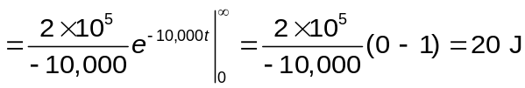
Chapter 1 – Circuit Variables (17 of 21)
Chapter 1 examples: Find the total energy delivered to the circuit element.
Notes:
Long Description 1:
w equals Integral from 0 to infinity Open Parenthesis 20 times e to the negative 5000 t power Close Parenthesis Open Parenthesis 10 to the 4 power times e to the negative 5000 t power Close Parenthesis d t plus 0 equals 2 multiplied by 10 to the 5 power Integral from 0 to infinity of e to the negative 10,000 t power d t.
Long Description 2:
equals Start Fraction 2 multiplied by 10 to the 5 power over negative 10,000 End Fraction e to the negative 10,000 t power Evaluation at the upper limit of infinity and the lower limit of 0 equals Start Fraction 2 multiplied by 10 to the 5 power over negative 10,000 End Fraction Open Parenthesis 0 minus 1 Close Parenthesis equals 20 Joules.

Slide 56
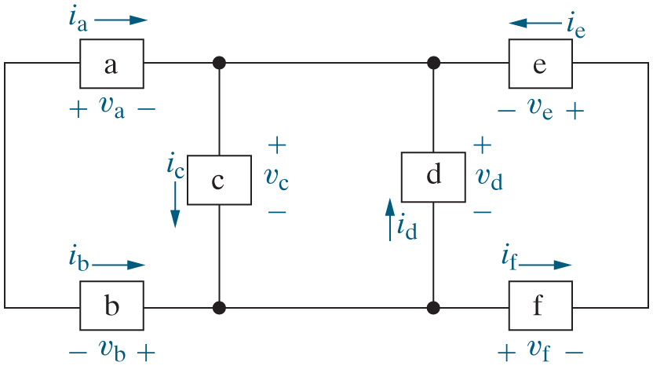












Chapter 1 – Circuit Variables (19 of 21)
Chapter 1 examples: Find the power associated with each circuit element in the circuit below.

Slide 57

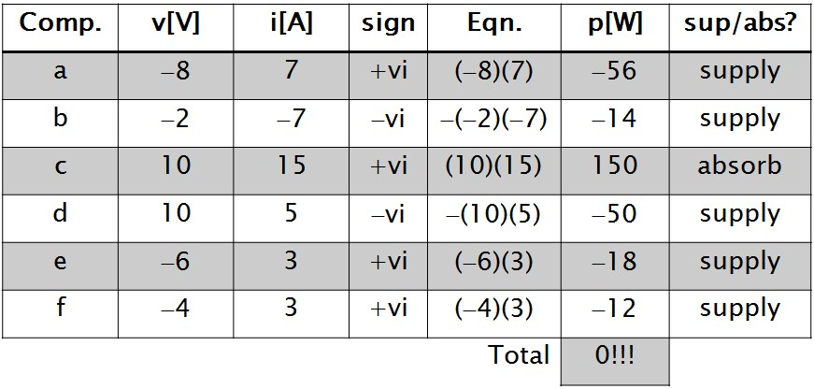
Chapter 1 – Circuit Variables (20 of 21)

